Slide 1
Brain Tumor Detection Project
An end-to-end machine learning project to detect brain tumors from MRI images.

Slide 2
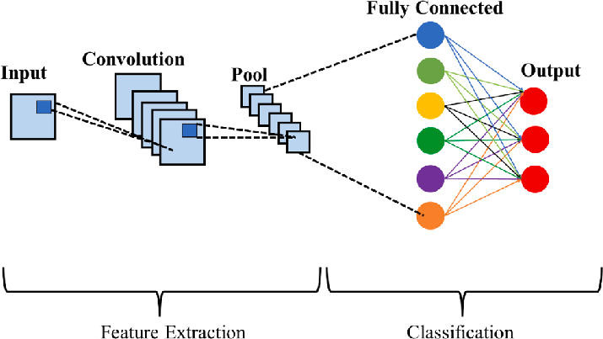
Data Collection & Training
Image Placeholder
• Dataset: MRI images classified into categories - glioma, meningioma, notumor, and pituitary.
• Data Augmentation: Techniques applied to increase dataset size and variability.
• Model: CNN model trained to classify images into four categories.

Slide 3
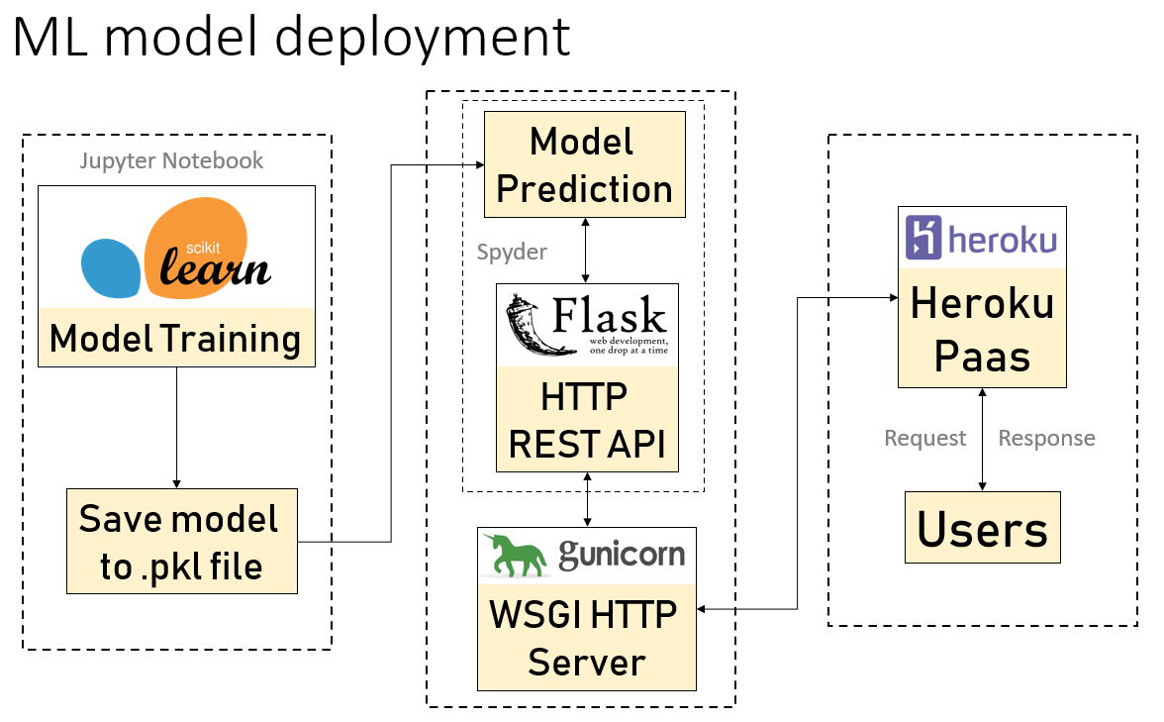
Model Deployment with Flask
• Flask API: Used to deploy the trained model for inference.
• Integration: Enables users to upload MRI images and receive predictions.
• Model Hosting: Flask serves as the backend interface for real-time predictions.

Slide 4
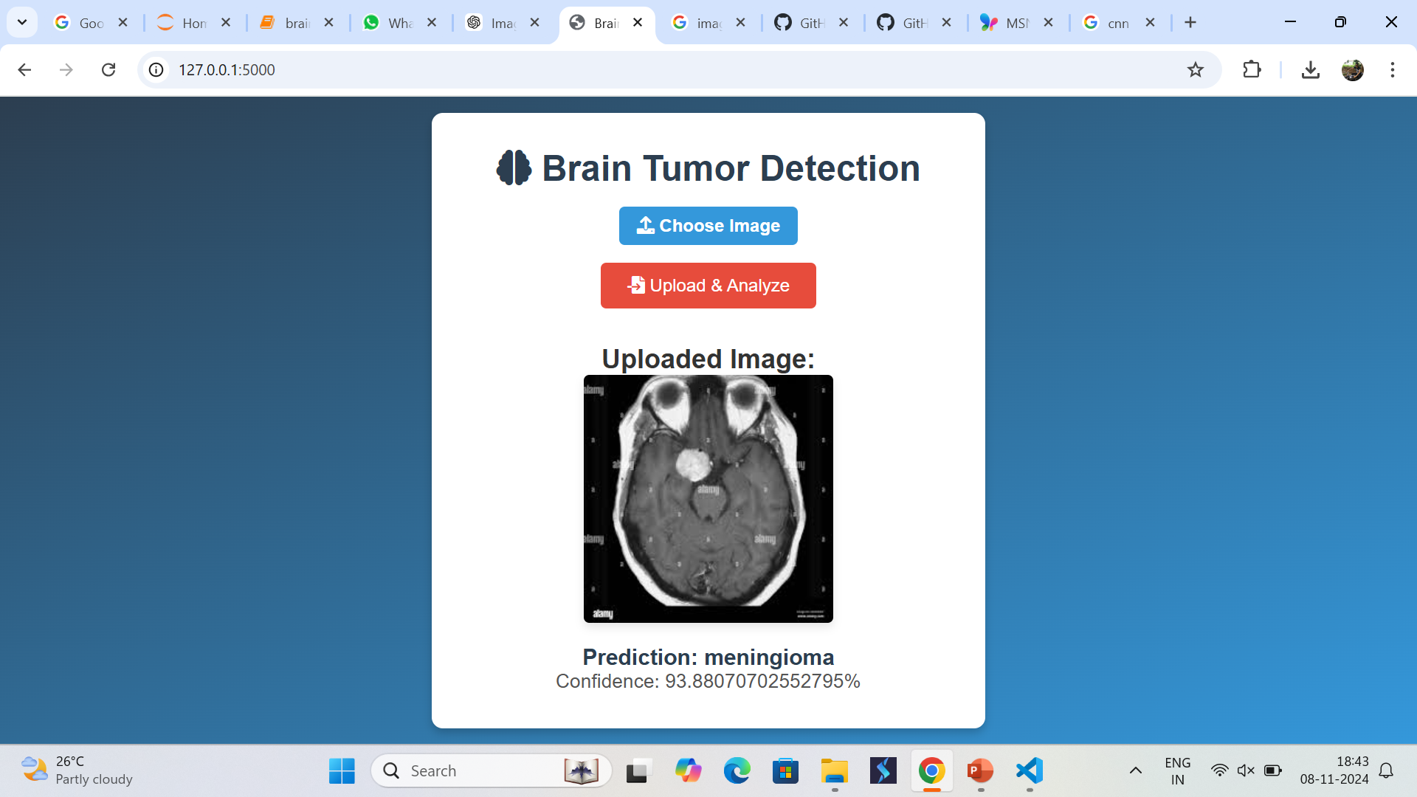
User Interface
• HTML : Web interface built for uploading images and displaying results.
• Image Display: Uploaded images are shown with predictions and confidence scores.
• Responsive Design: Enhances user experience with a clean, professional UI.

Slide 5

Future Scope & Enhancements
Image Placeholder
• Enhanced Model: Explore advanced architectures to improve accuracy.
• Localization: Implement tumor localization for more precise detection.
• Deployment: Scale to cloud platforms for higher availability and speed.
• User Feedback: Gather data to refine the model and enhance prediction quality.

